Slide 1
SQL

Slide 2
COMPANY Database- ER DIAGRAM
name
number
location
fname
lname
1
minit
works for
N
department
address
salary
name
sex
1
number of
employees
startdate
1
ssn
employee
manages
controls
bdate
1
supervisor
N
hours
N
degree
supervisee
supervision
1
works on
M
project
dependents of
name
number
location
N
dependent
name
sex
birthdate
relationship
Slide 8-<number>

Slide 3

COMPANY Database- ER DIAGRAM to SCHEMA
Slide 8-<number>

Slide 4

COMPANY Database state
Slide 8-<number>

Slide 5
SQL- Structured Query Language
Is a computer language for storing, manipulating and retrieving data stored in a relational database
First commercial language introduced for E.F Codd’s Relational Model
Slide 8-<number>

Slide 6
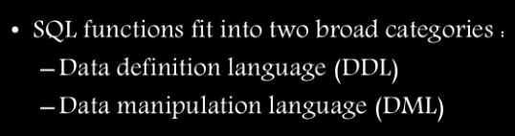
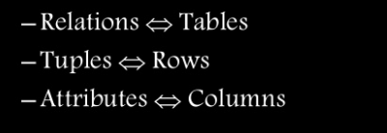
Slide 8-<number>

Slide 7
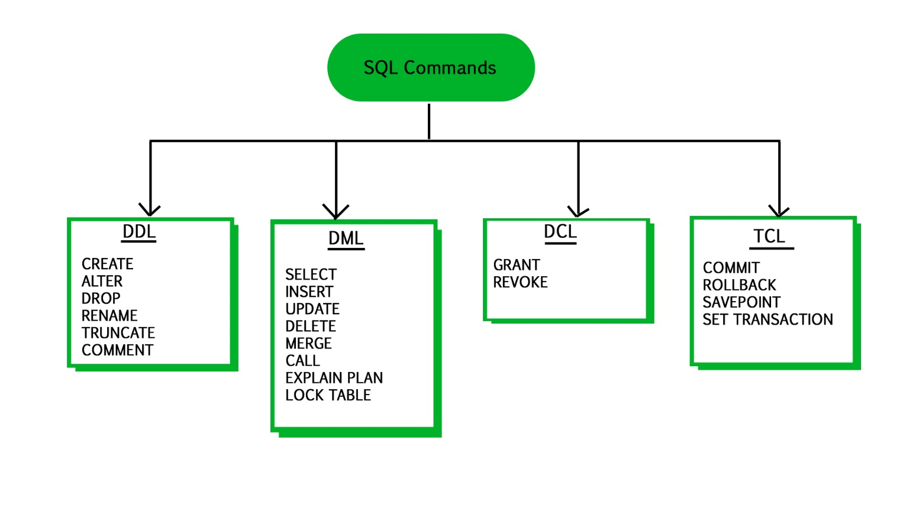
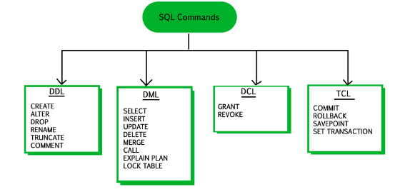
Slide 8-<number>

Slide 8
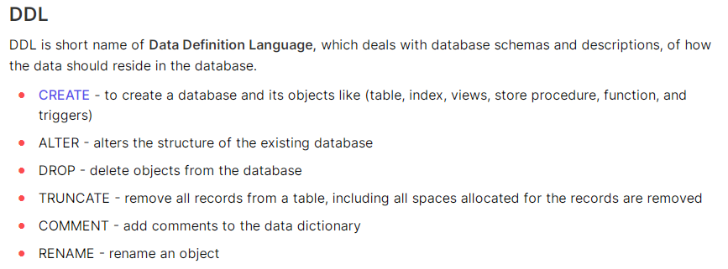
Slide 8-<number>

Slide 9
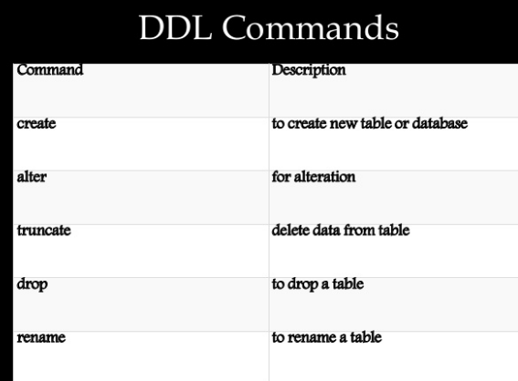
Slide 8-<number>

Slide 10
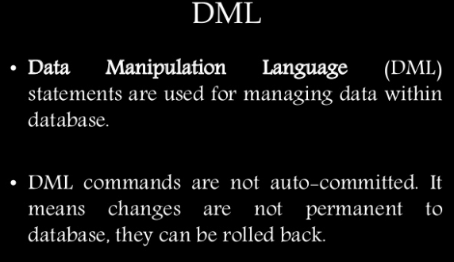
Slide 8-<number>

Slide 11
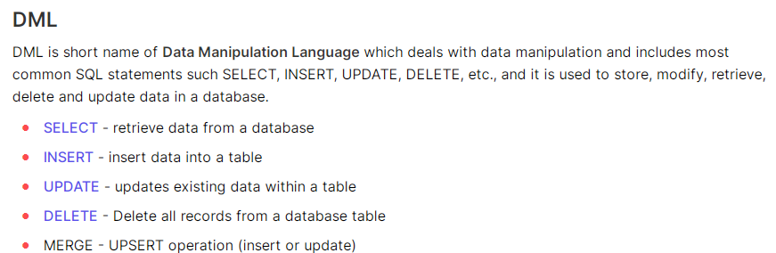
Slide 8-<number>

Slide 12
Data Definition, Constraints, and Schema Changes
Used to CREATE, DROP, and ALTER the descriptions of the tables (relations) of a database
Slide 8-<number>

Slide 13

Create table
SQL CREATE TABLE Syntax
CREATE TABLE table_name
(
column_name1 data_type(size),
column_name2 data_type(size),
column_name3 data_type(size),
....
);
CREATE TABLE Persons
(
PersonID int,
LastName varchar(255),
FirstName varchar(255),
Address varchar(255),
City varchar(255)
);
Slide 8-<number>

Slide 14
CREATE TABLE
Specifies a new base relation by giving it a name, and specifying each of its attributes and their data types (INTEGER, FLOAT, DECIMAL(i,j), CHAR(n), VARCHAR(n))
A constraint NOT NULL may be specified on an attribute
CREATE TABLE DEPARTMENT
( DNAME VARCHAR(10) NOT NULL,
DNUMBER INTEGER NOT NULL,
MGRSSN CHAR(9),
MGRSTARTDATE CHAR(9) );
Slide 8-<number>

Slide 15
CREATE TABLE
In SQL2, can use the CREATE TABLE command for specifying the primary key attributes, secondary keys, and referential integrity constraints (foreign keys).
Key attributes can be specified via the PRIMARY KEY and UNIQUE phrases
  CREATE TABLE Dept
  ( Dname VARCHAR(10) NOT NULL,
  Dnum INTEGER NOT NULL,
  Mgrssn CHAR(9),
  Mgrstartdate CHAR(9),
  PRIMARY KEY (Dnum),
  UNIQUE (Dname),
  FOREIGN KEY (Mgrssn) REFERENCES Emp );
Slide 8-<number>

Slide 16
SQL Constraints
SQL constraints are used to specify rules for the data in a table.
The following constraints are commonly used in SQL:
NOT NULL - Ensures that a column cannot have a NULL value
PRIMARY KEY - A combination of a NOT NULL and UNIQUE. Uniquely identifies each row in a table
FOREIGN KEY - Prevents actions that would destroy links between tables
CHECK - Ensures that the values in a column satisfies a specific condition
DEFAULT - Sets a default value for a column if no value is specified
UNIQUE - Ensures that all values in a column are different
Slide 8-<number>

Slide 17
REFERENTIAL INTEGRITY OPTIONS
We can specify RESTRICT, CASCADE, SET NULL or SET DEFAULT on referential integrity constraints (foreign keys)
CREATE TABLE DEPT
( DNAME VARCHAR(10) NOT NULL,
DNUMBER INTEGER NOT NULL,
MGRSSN CHAR(9),
MGRSTARTDATE CHAR(9),
PRIMARY KEY (DNUMBER),
UNIQUE (DNAME),
FOREIGN KEY (MGRSSN) REFERENCES EMP
ON DELETE CASCADE );
DELETE CASCADE : We use ON DELETE cascade when we want that all referenced entities will automatically delete if we delete any parent entity.
Slide 8-<number>

Slide 18
REFERENTIAL INTEGRITY OPTIONS
We can specify RESTRICT, CASCADE, SET NULL or SET DEFAULT on referential integrity constraints (foreign keys)
CREATE TABLE DEPT
( DNAME VARCHAR(10) NOT NULL,
DNUMBER INTEGER NOT NULL,
MGRSSN CHAR(9),
MGRSTARTDATE CHAR(9),
PRIMARY KEY (DNUMBER),
UNIQUE (DNAME),
FOREIGN KEY (MGRSSN) REFERENCES EMP
ON UPDATE CASCADE );
UPDATE CASCADE : This is the same as ON DELETE cascade. The difference is that instead of delete referenced table data it will update the data.
Slide 8-<number>

Slide 19
ON DELETE CASCADE
    It specifies that the child data is deleted when the parent data is deleted.
ON UPDATE
    Optional. It specifies what to do with the child data when the parent data is updated. You have the options of NO ACTION, CASCADE, SET NULL, or SET DEFAULT.
Slide 8-<number>

Slide 20
REFERENTIAL INTEGRITY OPTIONS
We can specify RESTRICT, CASCADE, SET NULL or SET DEFAULT on referential integrity constraints (foreign keys)
CREATE TABLE DEPT
( DNAME VARCHAR(10) NOT NULL,
DNUMBER INTEGER NOT NULL,
MGRSSN CHAR(9),
MGRSTARTDATE CHAR(9),
PRIMARY KEY (DNUMBER),
UNIQUE (DNAME),
FOREIGN KEY (MGRSSN) REFERENCES EMP
ON DELETE SET DEFAULT ON UPDATE CASCADE );
Slide 8-<number>

Slide 21
REFERENTIAL INTEGRITY OPTIONS (continued)
  CREATE TABLE EMP
  ( ENAME VARCHAR(30) NOT NULL,
  ESSN CHAR(9),
  BDATE DATE,
  DNO INTEGER DEFAULT 1,
  SUPERSSN CHAR(9),
  PRIMARY KEY (ESSN),
  FOREIGN KEY (DNO) REFERENCES DEPT
  ON DELETE SET DEFAULT ON UPDATE CASCADE,
  FOREIGN KEY (SUPERSSN) REFERENCES EMP
  ON DELETE SET NULL ON UPDATE CASCADE );
Slide 8-<number>

Slide 22

DROP TABLE
Used to remove a relation (base table) and its definition
The relation can no longer be used in queries, updates, or any other commands since its description no longer exists
Example:
DROP TABLE DEPENDENT;
DROP TABLE table_name
Slide 8-<number>

Slide 23




ALTER TABLE
To add a column in a table :
To delete a column in a table
Example
Syntax
ALTER TABLE table_name
ADD column_name datatype
ALTER TABLE Persons
ADD email varchar(20);
ALTER TABLE table_name
DROP column_name
ALTER TABLE Persons
DROP column email;
Slide 8-<number>

Slide 24


To create a PRIMARY KEY constraint on the "ID" column when the table is already created
To drop a PRIMARY KEY constraint,
ALTER TABLE Persons
ADD PRIMARY KEY (ID);
ALTER TABLE Persons
DROP PRIMARY KEY;
Slide 8-<number>

Slide 25
ALTER TABLE
Used to add an attribute to one of the base relations
The new attribute will have NULLs in all the tuples of the relation right after the command is executed; hence, the NOT NULL constraint is not allowed for such an attribute
Example:
ALTER TABLE EMPLOYEE ADD JOB VARCHAR(12);
The database users must still enter a value for the new attribute JOB for each EMPLOYEE tuple. This can be done using the UPDATE command.
Slide 8-<number>

Slide 26
Additional Data Types in SQL2 and SQL-99
Has DATE, TIME, and TIMESTAMP data types
DATE:
  Made up of year-month-day in the format yyyy-mm-dd
TIME:
  Made up of hour:minute:second in the format hh:mm:ss
TIME(i):
  Made up of hour:minute:second plus i additional digits specifying fractions of a second
  format is hh:mm:ss:ii...i
TIMESTAMP:
  Has both DATE and TIME components
Slide 8-<number>

Slide 27
Additional Data Types in SQL2 and SQL-99 (cont.)
INTERVAL:
  Specifies a relative value rather than an absolute value
  Can be DAY/TIME intervals or YEAR/MONTH intervals
  Can be positive or negative when added to or subtracted from an absolute value, the result is an absolute value
  query
  Result: 2017-06-15 09:49:21
SELECT DATE_ADD("2017-06-15 09:34:21", INTERVAL 15 MINUTE);
Slide 8-<number>

Slide 28
Specifying Updates in SQL
There are three SQL commands to modify the database; INSERT, DELETE, and UPDATE
Slide 8-<number>

Slide 29
INSERT
In its simplest form, it is used to add one or more tuples to a relation
Attribute values should be listed in the same order as the attributes were specified in the CREATE TABLE command
Slide 8-<number>

Slide 30
INSERT (cont.)
Example:
U1: INSERT INTO EMPLOYEE
VALUES ('Richard','K','Marini', '653298653', '30-DEC-52',
'98 Oak Forest,Katy,TX', 'M', 37000,'987654321', 4 )
An alternate form of INSERT specifies explicitly the attribute names that correspond to the values in the new tuple
Attributes with NULL values can be left out
Example: Insert a tuple for a new EMPLOYEE for whom we only know the FNAME, LNAME, and SSN attributes.
U1A: INSERT INTO EMPLOYEE (FNAME, LNAME, SSN)
VALUES ('Richard', 'Marini', '653298653')
Slide 8-<number>

Slide 31
Retrieval Queries in SQL
SQL has one basic statement for retrieving information from a database; the SELECT statement
This is not the same as the SELECT operation of the relational algebra
Important distinction between SQL and the formal relational model; SQL allows a table (relation) to have two or more tuples that are identical in all their attribute values
Hence, an SQL relation (table) is a multi-set (sometimes called a bag) of tuples; it is not a set of tuples
SQL relations can be constrained to be sets by specifying PRIMARY KEY or UNIQUE attributes, or by using the DISTINCT option in a query
Slide 8-<number>

Slide 32
Retrieval Queries in SQL (cont.)
Basic form of the SQL SELECT statement is called a mapping or a SELECT-FROM-WHERE block
  SELECT <attribute list>
  FROM <table list>
  WHERE <condition>
  <attribute list> is a list of attribute names whose values are to be retrieved by the query
  <table list> is a list of the relation names required to process the query
  <condition> is a conditional (Boolean) expression that identifies the tuples to be retrieved by the query
Slide 8-<number>

Slide 33
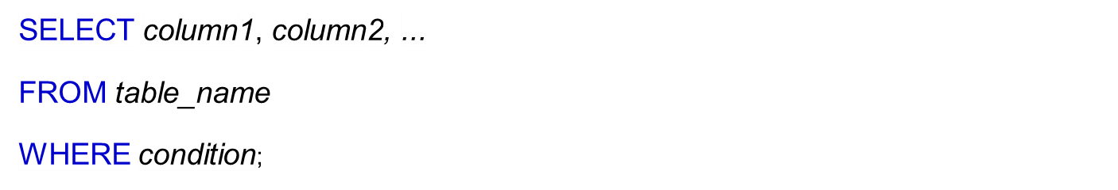


SQL WHERE CLAUSE

Slide 34
OPERATORS IN THE WHERE CLAUSE
Operator | Description
= | EQUAL
> | GREATER THAN
< | LESS THAN
>= | GREATER THAN OR EQUAL
<= | LESS THAN OR EQUAL
<> | NOT EQUAL
BETWEEN | BETWEEN A RANGE
LIKE | SEARCH FOR A PATTERN
IN | TO SPECIFY MULTIPLE POSSIBLE VALUES FROM A COLUMN

Slide 35


CONNECTORS- AND , OR, NOT

Slide 36
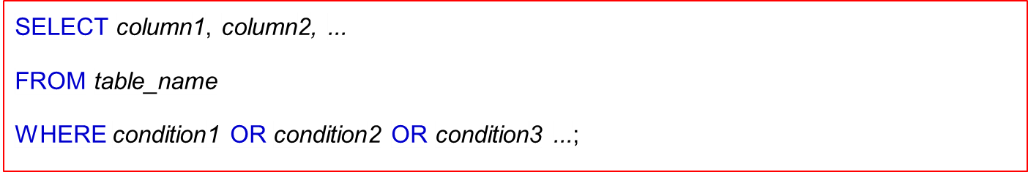

CONNECTORS- AND , OR, NOT

Slide 37


CONNECTORS- AND , OR, NOT

Slide 38
Simple SQL Query
Product
PName | Price | Category | Manufacturer
Gizmo | $19.99 | Gadgets | GizmoWorks
Powergizmo | $29.99 | Gadgets | GizmoWorks
SingleTouch | $149.99 | Photography | Canon
MultiTouch | $203.99 | Household | Hitachi
SELECT *
FROM Product
WHERE category=‘Gadgets’
PName | Price | Category | Manufacturer
Gizmo | $19.99 | Gadgets | GizmoWorks
Powergizmo | $29.99 | Gadgets | GizmoWorks
“selection”

Slide 39
Simple SQL Query
Product
PName | Price | Category | Manufacturer
Gizmo | $19.99 | Gadgets | GizmoWorks
Powergizmo | $29.99 | Gadgets | GizmoWorks
SingleTouch | $149.99 | Photography | Canon
MultiTouch | $203.99 | Household | Hitachi
SELECT PName, Price, Manufacturer
FROM Product
WHERE Price > 100
“selection” and
“projection”
PName | Price | Manufacturer
SingleTouch | $149.99 | Canon
MultiTouch | $203.99 | Hitachi

Slide 40

Relational Database Schema--Figure 5.5
Slide 8-<number>

Slide 41

Populated Database--Fig.5.6
Slide 8-<number>

Slide 42
Simple SQL Queries
Basic SQL queries correspond to using the SELECT, PROJECT, and JOIN operations of the relational algebra
All subsequent examples use the COMPANY database
Example of a simple query on one relation
Query 0: Retrieve the birthdate and address of the employee whose name is 'John B. Smith'.
  Q0: SELECT BDATE, ADDRESS
  FROM EMPLOYEE
  WHERE FNAME='John' AND MINIT='B’
  AND LNAME='Smith’
  Similar to a SELECT-PROJECT pair of relational algebra operations; the SELECT-clause specifies the projection attributes and the WHERE-clause specifies the selection condition
  However, the result of the query may contain duplicate tuples
Slide 8-<number>

Slide 43
Simple SQL Queries (cont.)
Query 1: Retrieve the name and address of all employees who work for the 'Research' department.
  Q1: SELECT FNAME, LNAME, ADDRESS
  FROM EMPLOYEE, DEPARTMENT
  WHERE DNAME='Research' AND DNUMBER=DNO
  Similar to a SELECT-PROJECT-JOIN sequence of relational algebra operations
  (DNAME='Research') is a selection condition (corresponds to a SELECT operation in relational algebra)
  (DNUMBER=DNO) is a join condition (corresponds to a JOIN operation in relational algebra)
Slide 8-<number>

Slide 44
Simple SQL Queries (cont.)
Query 2: For every project located in 'Stafford', list the project number, the controlling department number, and the department manager's last name, address, and birthdate.
  Q2: SELECT PNUMBER, DNUM, LNAME, BDATE, ADDRESS
  FROM PROJECT, DEPARTMENT, EMPLOYEE
  WHERE DNUM=DNUMBER AND MGRSSN=SSN AND PLOCATION='Stafford'
  In Q2, there are two join conditions
  The join condition DNUM=DNUMBER relates a project to its controlling department
  The join condition MGRSSN=SSN relates the controlling department to the employee who manages that department
Slide 8-<number>

Slide 45



SQL UPDATE

Slide 46


SQL DELETE

Slide 47
Aliases
Aliases are used to temporarily rename a table name or a column name
For Table
Select P.dno, E.dno
from Project as P, Employee as E
where P.dno=E.dno;
SELECT column name
FROM table1 AS alias_name,table2 AS alias_name
WHERE condition1;
Slide 8-<number>

Slide 48
Aliases contin..
For Column
Select dno AS project_number
from Project ;
SELECT column name AS alias_name
FROM table;
Slide 8-<number>

Slide 49
AGGREGATE FUNCTIONS
Include COUNT, SUM, MAX, MIN, and AVG
Slide 8-<number>

Slide 50
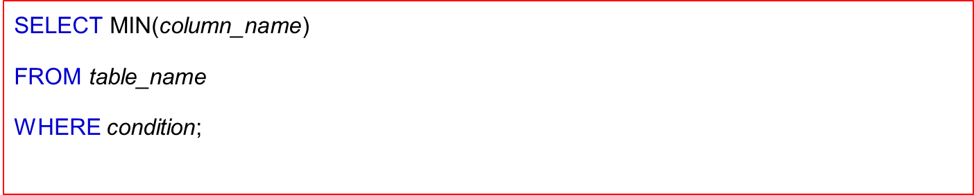


SQL MIN( )

Slide 51
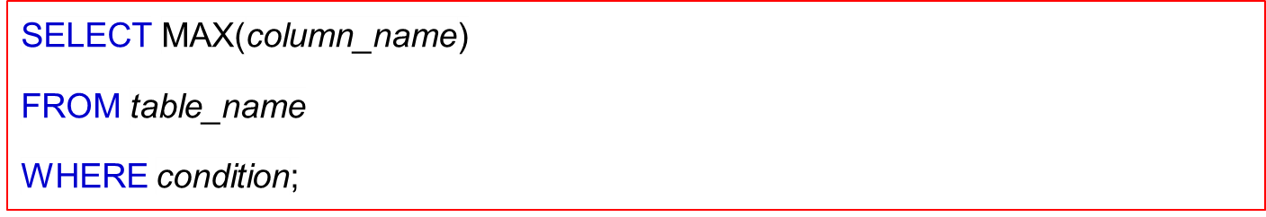

SQL MAX( )

Slide 52
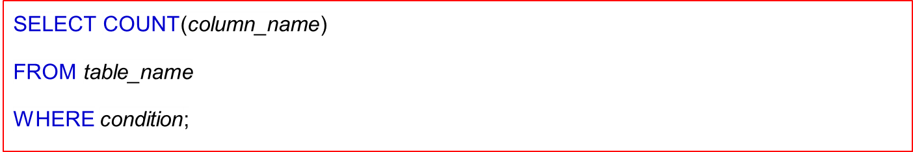

SQL COUNT( )

Slide 53
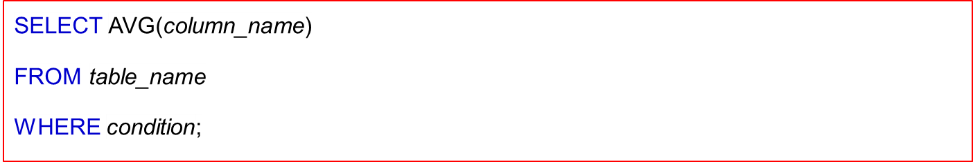

SQL AVG( )

Slide 54


SQL SUM( )

Slide 55
SUBSTRING COMPARISON
The LIKE comparison operator is used to compare partial strings
Two reserved characters are used: '%' (or '*' in some implementations) replaces an arbitrary number of characters, and '_' replaces a single arbitrary character
Slide 8-<number>

Slide 56

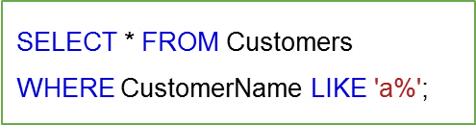
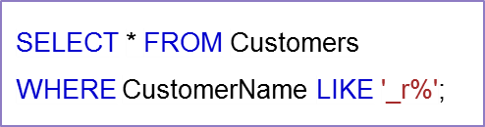
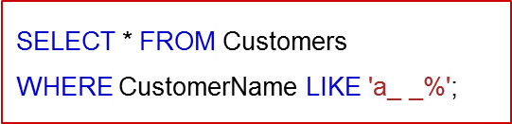
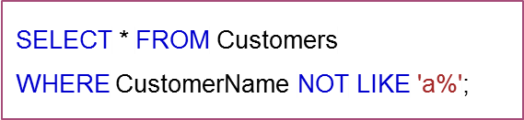
SQL LIKE OPERATOR

Slide 57
SUBSTRING COMPARISON (cont.)
Query 25: Retrieve all employees whose address is in Houston, Texas. Here, the value of the ADDRESS attribute must contain the substring 'Houston,TX'.
Q25: SELECT FNAME, LNAME
FROM EMPLOYEE
WHERE ADDRESS LIKE '%Houston,TX%’
Slide 8-<number>

Slide 58


SQL DISTINCT

Slide 59
Aggregate example
Query 15: Find the maximum salary, the minimum salary, and the average salary among all employees.
Q15: SELECT MAX(SALARY), MIN(SALARY), AVG(SALARY)
FROM EMPLOYEE
  Some SQL implementations may not allow more than one function in the SELECT-clause
Slide 8-<number>

Slide 60
ALIASES
Some queries need to refer to the same relation twice
In this case, aliases are given to the relation name
Query 8: For each employee, retrieve the employee's name, and the name of his or her immediate supervisor.
Q8: SELECT E.FNAME, E.LNAME, S.FNAME, S.LNAME
FROM EMPLOYEE E ,EMPLOYEE S
WHERE E.SUPERSSN=S.SSN
  In Q8, the alternate relation names E and S are called aliases or tuple variables for the EMPLOYEE relation
  We can think of E and S as two different copies of EMPLOYEE; E represents employees in role of supervisees and S represents employees in role of supervisors
Slide 8-<number>

Slide 61
SET OPERATIONS (cont.)
Query 4: Make a list of all project numbers for projects that involve an employee whose last name is 'Smith' as a worker or as a manager of the department that controls the project.
Q4: (SELECT PNAME
FROM PROJECT, DEPARTMENT, EMPLOYEE
WHERE DNUM=DNUMBER AND MGRSSN=SSN AND LNAME='Smith')
UNION (SELECT PNAME
FROM PROJECT, WORKS_ON, EMPLOYEE
WHERE PNUMBER=PNO AND ESSN=SSN AND LNAME='Smith')
Slide 8-<number>

Slide 62
USE OF *
To retrieve all the attribute values of the selected tuples, a * is used, which stands for all the attributes
Examples:
Q1C: SELECT *
FROM EMPLOYEE
WHERE DNO=5
Q1D: SELECT *
FROM EMPLOYEE, DEPARTMENT
WHERE DNAME='Research' AND DNO=DNUMBER
Slide 8-<number>

Slide 63
SET OPERATIONS
SQL has directly incorporated some set operations
There is a union operation (UNION), and in some versions of SQL there are set difference (MINUS) and intersection (INTERSECT) operations
The resulting relations of these set operations are sets of tuples; duplicate tuples are eliminated from the result
The set operations apply only to union compatible relations ; the two relations must have the same attributes and the attributes must appear in the same order
Slide 8-<number>

Slide 64
Operators in nested queries
IN operator
- allows to specify multiple values in a WHERE clause
Example
SELECT * FROM Customers
WHERE Country IN ('Germany', 'France', 'UK');
Syntax
SELECT column_name(s)
FROM table_name
WHERE column_name IN (value1, value2, ...);
Slide 8-<number>

Slide 65
The SQL ALL Operator
returns a boolean value as a result
returns TRUE if ALL of the subquery values meet the condition
is used with SELECT, WHERE and HAVING statements
SELECT ProductName
FROM Products
WHERE ProductID = ALL
(SELECT ProductID
FROM OrderDetails
WHERE Quantity = 10);
The following SQL statement lists the ProductName if ALL the records in the OrderDetails table has Quantity equal to 10. This will of course return FALSE because the Quantity column has many different values (not only the value of 10):
Slide 8-<number>

Slide 66
The SQL ANY Operator
The ANY operator:
returns a boolean value as a result
returns TRUE if ANY of the subquery values meet the condition
SELECT ProductName
FROM Products
WHERE ProductID = ANY
(SELECT ProductID
FROM OrderDetails
WHERE Quantity = 10);
The following SQL statement lists the ProductName if it finds ANY records in the OrderDetails table has Quantity equal to 10 (this will return TRUE because the Quantity column has some values of 10):
Slide 8-<number>

Slide 67
NESTING OF QUERIES
A complete SELECT query, called a nested query , can be specified within the WHERE-clause of another query, called the outer query
Many of the previous queries can be specified in an alternative form using nesting
SELECT select_list FROM table
WHERE condition
(SELECT select_list FROM table)
A subquery is used to return data that will be used in the main query as a condition to further restrict the data to be retrieved
Slide 8-<number>

Slide 68
Employees schema
Write a query to display the name ( first name and last name ) for those employees who gets more salary than the employee whose id is 163.
SELECT first_name, last_name FROM employees
WHERE salary > ( SELECT salary FROM employees WHERE employee_id=163 );
Slide 8-<number>

Slide 69
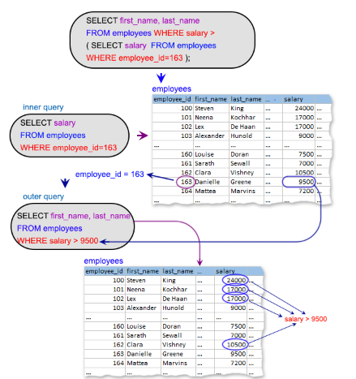
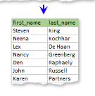
Slide 8-<number>
Pictorial Presentation( previous example):

Slide 70
2. Write a query to display the name ( first name and last name ), salary, department id, job id for those employees who works in the same designation as the employee works whose id is 169.
SELECT first_name, last_name, salary, department_id, job_id FROM employees WHERE job_id = ( SELECT job_id FROM employees WHERE employee_id=169 );
3. Write a query to display the name ( first name and last name ), salary, department id for those employees who earn such amount of salary which is the smallest salary of any of the departments.
SELECT first_name, last_name, salary, department_id
FROM employees
WHERE salary IN
( SELECT MIN(salary)
FROM employees
GROUP BY department_id );
Slide 8-<number>

Slide 71
NESTING OF QUERIES
A complete SELECT query, called a nested query , can be specified within the WHERE-clause of another query, called the outer query
Many of the previous queries can be specified in an alternative form using nesting
Query 1: Retrieve the name and address of all employees who work for the 'Research' department.
Q1: SELECT select_list FROM table
WHERE condition
(SELECT select_list FROM table)
A subquery is used to return data that will be used in the main query as a condition to further restrict the data to be retrieved
Slide 8-<number>

Slide 72
Query 1: Retrieve the name and address of all employees who work for the 'Research' department.
Q1: SELECT FNAME, LNAME, ADDRESS
FROM EMPLOYEE
WHERE DNO IN (SELECT DNUMBER
FROM DEPARTMENT
WHERE DNAME='Research' )
The nested query selects the number of the 'Research' department
The outer query select an EMPLOYEE tuple if its DNO value is in the result of either nested query
The comparison operator IN compares a value v with a set (or multi-set) of values V, and evaluates to TRUE if v is one of the elements in V
Slide 8-<number>

Slide 73
CORRELATED NESTED QUERIES
If a condition in the WHERE-clause of a nested query references an attribute of a relation declared in the outer query , the two queries are said to be correlated
The result of a correlated nested query is different for each tuple (or combination of tuples) of the relation(s) the outer query
Query 12: Retrieve the name of each employee who has a dependent with the same first name as the employee.
Q12: SELECT E.FNAME, E.LNAME
FROM EMPLOYEE AS E
WHERE E.SSN IN (SELECT ESSN
FROM DEPENDENT
WHERE ESSN=E.SSN AND
E.FNAME=DEPENDENT_NAME)
Slide 8-<number>

Slide 74
CORRELATED NESTED QUERIES (cont.)
  In Q12, the nested query has a different result for each tuple in the outer query
  A query written with nested SELECT... FROM... WHERE... blocks and using the = or IN comparison operators can always be expressed as a single block query. For example, Q12 may be written as in Q12A
  Q12A: SELECT E.FNAME, E.LNAME
  FROM EMPLOYEE E, DEPENDENT D
  WHERE E.SSN=D.ESSN AND E.FNAME=D.DEPENDENT_NAME
  The original SQL as specified for SYSTEM R also had a CONTAINS comparison operator, which is used in conjunction with nested correlated queries
  This operator was dropped from the language, possibly because of the difficulty in implementing it efficiently
Slide 8-<number>

Slide 75
CORRELATED NESTED QUERIES (cont.)
  Most implementations of SQL do not have this operator
  The CONTAINS operator compares two sets of values , and returns TRUE if one set contains all values in the other set
  (reminiscent of the division operation of algebra).
    Query 3: Retrieve the name of each employee who works on all the projects controlled by department number 5.
    Q3: SELECT FNAME, LNAME
    FROM EMPLOYEE
    WHERE ( (SELECT PNO
    FROM WORKS_ON
    WHERE SSN=ESSN)
    CONTAINS
    (SELECT PNUMBER
    FROM PROJECT
    WHERE DNUM=5) )
Slide 8-<number>

Slide 76
CORRELATED NESTED QUERIES (cont.)
      In Q3, the second nested query, which is not correlated with the outer query, retrieves the project numbers of all projects controlled by department 5
      The first nested query, which is correlated, retrieves the project numbers on which the employee works, which is different for each employee tuple because of the correlation
Slide 8-<number>

Slide 77
THE EXISTS FUNCTION
EXISTS operator – to check the existence of a result of a subquery is empty (contains no tuples) or not
Example.
SELECT employee_id, manager_id, first_name, last_name
FROM employees a
WHERE EXISTS (SELECT employee_id
FROM employees b
WHERE b.manager_id = a.employee_id)
Slide 8-<number>

Slide 78
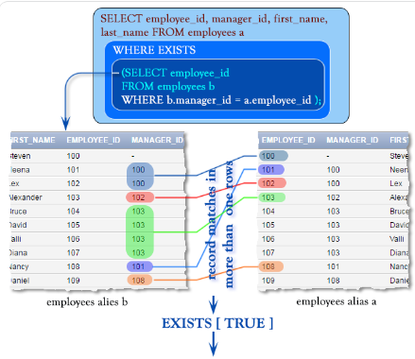
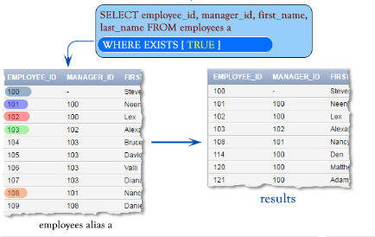
Slide 8-<number>

Slide 79
THE EXISTS FUNCTION (cont.)
Query 12: Retrieve the name of each employee who has a dependent with the same first name as the employee.
Q12B: SELECT FNAME, LNAME
FROM EMPLOYEE
WHERE EXISTS (SELECT *
FROM DEPENDENT
WHERE SSN=ESSN AND FNAME=DEPENDENT_NAME)
Slide 8-<number>

Slide 80
THE EXISTS FUNCTION (cont.)
Query 6: Retrieve the names of employees who have no dependents.
Q6: SELECT FNAME, LNAME
FROM EMPLOYEE
WHERE NOT EXISTS (SELECT *
FROM DEPENDENT
WHERE SSN=ESSN)
  In Q6, the correlated nested query retrieves all DEPENDENT tuples related to an EMPLOYEE tuple. If none exist , the EMPLOYEE tuple is selected
  EXISTS is necessary for the expressive power of SQL
Slide 8-<number>

Slide 81
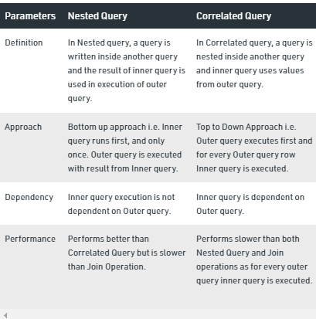
Slide 8-<number>

Slide 82
EXPLICIT SETS
It is also possible to use an explicit (enumerated) set of values in the WHERE-clause rather than a nested query
Query 13: Retrieve the social security numbers of all employees who work on project number 1, 2, or 3.
  Q13: SELECT DISTINCT ESSN
  FROM WORKS_ON
  WHERE PNO IN (1, 2, 3)
Slide 8-<number>

Slide 83
NULLS IN SQL QUERIES
SQL allows queries that check if a value is NULL (missing or undefined or not applicable)
SQL uses IS or IS NOT to compare NULLs because it considers each NULL value distinct from other NULL values, so equality comparison is not appropriate .
Query 14: Retrieve the names of all employees who do not have supervisors.
Q14: SELECT FNAME, LNAME
FROM EMPLOYEE
WHERE SUPERSSN IS NULL
Note: If a join condition is specified, tuples with NULL values for the join attributes are not included in the result
Slide 8-<number>

Slide 84
Joined Relations Feature in SQL2
Can specify a "joined relation" in the FROM-clause
Looks like any other relation but is the result of a join
Allows the user to specify different types of joins (regular "theta" JOIN, NATURAL JOIN, LEFT OUTER JOIN, RIGHT OUTER JOIN, CROSS JOIN, etc)
Slide 8-<number>

Slide 85
Joined Relations Feature in SQL2 (cont.)
Examples:
Q8: SELECT E.FNAME, E.LNAME, S.FNAME, S.LNAME
FROM EMPLOYEE E S
WHERE E.SUPERSSN=S.SSN
can be written as:
Q8: SELECT E.FNAME, E.LNAME, S.FNAME, S.LNAME
FROM (EMPLOYEE E LEFT OUTER JOIN EMPLOYEES
ON E.SUPERSSN=S.SSN)
Q1: SELECT FNAME, LNAME, ADDRESS
FROM EMPLOYEE, DEPARTMENT
WHERE DNAME='Research' AND DNUMBER=DNO
Slide 8-<number>

Slide 86
Joined Relations Feature in SQL2 (cont.)
could be written as:
Q1: SELECT FNAME, LNAME, ADDRESS
FROM (EMPLOYEE JOIN DEPARTMENT
ON DNUMBER=DNO)
WHERE DNAME='Research’
or as:
Q1: SELECT FNAME, LNAME, ADDRESS
FROM (EMPLOYEE NATURAL JOIN DEPARTMENT
AS DEPT(DNAME, DNO, MSSN, MSDATE)
WHERE DNAME='Research’
Slide 8-<number>

Slide 87
Joined Relations Feature in SQL2 (cont.)
Another Example;
  Q2 could be written as follows; this illustrates multiple joins in the joined tables
  Q2: SELECT PNUMBER, DNUM, LNAME, BDATE, ADDRESS
  FROM (PROJECT JOIN DEPARTMENT ON DNUM=DNUMBER) JOIN EMPLOYEE ON MGRSSN=SSN) )
  WHERE PLOCATION='Stafford’
Slide 8-<number>

Slide 88
GROUPING
In many cases, we want to apply the aggregate functions to subgroups of tuples in a relation
Each subgroup of tuples consists of the set of tuples that have the same value for the grouping attribute(s)
The function is applied to each subgroup independently
SQL has a GROUP BY-clause for specifying the grouping attributes, which must also appear in the SELECT-clause
Slide 8-<number>

Slide 89
GROUPING (cont.)
Query 20: For each department, retrieve the department number, the number of employees in the department, and their average salary.
Q20: SELECT DNO, COUNT (*), AVG (SALARY)
FROM EMPLOYEE
GROUP BY DNO
  In Q20, the EMPLOYEE tuples are divided into groups--each group having the same value for the grouping attribute DNO
  The COUNT and AVG functions are applied to each such group of tuples separately
  The SELECT-clause includes only the grouping attribute and the functions to be applied on each group of tuples
  A join condition can be used in conjunction with grouping
Slide 8-<number>

Slide 90
GROUPING (cont.)
Query 21: For each project, retrieve the project number, project name, and the number of employees who work on that project.
Q21: SELECT PNUMBER, PNAME, COUNT (*)
FROM PROJECT, WORKS_ON
WHERE PNUMBER=PNO
GROUP BY PNUMBER, PNAME
  In this case, the grouping and functions are applied after the joining of the two relations
Slide 8-<number>

Slide 91
THE HAVING-CLAUSE
Sometimes we want to retrieve the values of these functions for only those groups that satisfy certain conditions
The HAVING-clause is used for specifying a selection condition on groups (rather than on individual tuples)
Slide 8-<number>

Slide 92
THE HAVING-CLAUSE (cont.)
Query 22: For each project on which more than two employees work , retrieve the project number, project name, and the number of employees who work on that project.
Q22: SELECT PNUMBER, PNAME, COUNT (*)
FROM PROJECT, WORKS_ON
WHERE PNUMBER=PNO
GROUP BY PNUMBER, PNAME
HAVING COUNT (*) > 2
Slide 8-<number>

Slide 93
SUBSTRING COMPARISON (cont.)
Query 26: Retrieve all employees who were born during the 1950s. Here, '5' must be the 8th character of the string (according to our format for date), so the BDATE value is '_______5_', with each underscore as a place holder for a single arbitrary character.
Q26: SELECT FNAME, LNAME
FROM EMPLOYEE
WHERE BDATE LIKE '_______5_’
The LIKE operator allows us to get around the fact that each value is considered atomic and indivisible; hence, in SQL, character string attribute values are not atomic
Slide 8-<number>

Slide 94
ARITHMETIC OPERATIONS
The standard arithmetic operators '+', '-'. '*', and '/' (for addition, subtraction, multiplication, and division, respectively) can be applied to numeric values in an SQL query result
Query 27: Show the effect of giving all employees who work on the 'ProductX' project a 10% raise.
Q27: SELECT FNAME, LNAME, 1.1*SALARY
FROM EMPLOYEE, WORKS_ON, PROJECT
WHERE SSN=ESSN AND PNO=PNUMBER AND PNAME='ProductX’
Slide 8-<number>

Slide 95
ORDER BY
The ORDER BY clause is used to sort the tuples in a query result based on the values of some attribute(s)
Query 28: Retrieve a list of employees and the projects each works in, ordered by the employee's department, and within each department ordered alphabetically by employee last name.
Q28: SELECT DNAME, LNAME, FNAME, PNAME
FROM DEPARTMENT, EMPLOYEE, WORKS_ON, PROJECT
WHERE DNUMBER=DNO AND SSN=ESSN AND PNO=PNUMBER
ORDER BY DNAME, LNAME
Slide 8-<number>

Slide 96
ORDER BY (cont.)
The default order is in ascending order of values
We can specify the keyword DESC if we want a descending order; the keyword ASC can be used to explicitly specify ascending order, even though it is the default
Slide 8-<number>

Slide 97
Summary of SQL Queries
A query in SQL can consist of up to six clauses, but only the first two, SELECT and FROM, are mandatory. The clauses are specified in the following order:
SELECT <attribute list>
FROM <table list>
[WHERE <condition>]
[GROUP BY <grouping attribute(s)>]
[HAVING <group condition>]
[ORDER BY <attribute list>]
Slide 8-<number>

Slide 98
Summary of SQL Queries (cont.)
The SELECT-clause lists the attributes or functions to be retrieved
The FROM-clause specifies all relations (or aliases) needed in the query but not those needed in nested queries
The WHERE-clause specifies the conditions for selection and join of tuples from the relations specified in the FROM-clause
GROUP BY specifies grouping attributes
HAVING specifies a condition for selection of groups
ORDER BY specifies an order for displaying the result of a query
A query is evaluated by first applying the WHERE-clause, then GROUP BY and HAVING, and finally the SELECT-clause
Slide 8-<number>

Slide 99
Specifying Updates in SQL
There are three SQL commands to modify the database; INSERT, DELETE, and UPDATE
Slide 8-<number>

Slide 100
INSERT
In its simplest form, it is used to add one or more tuples to a relation
Attribute values should be listed in the same order as the attributes were specified in the CREATE TABLE command
Slide 8-<number>

Slide 101
INSERT (cont.)
Example:
U1: INSERT INTO EMPLOYEE
VALUES ('Richard','K','Marini', '653298653', '30-DEC-52',
'98 Oak Forest,Katy,TX', 'M', 37000,'987654321', 4 )
An alternate form of INSERT specifies explicitly the attribute names that correspond to the values in the new tuple
Attributes with NULL values can be left out
Example: Insert a tuple for a new EMPLOYEE for whom we only know the FNAME, LNAME, and SSN attributes.
U1A: INSERT INTO EMPLOYEE (FNAME, LNAME, SSN)
VALUES ('Richard', 'Marini', '653298653')
Slide 8-<number>

Slide 102
INSERT (cont.)
Important Note: Only the constraints specified in the DDL commands are automatically enforced by the DBMS when updates are applied to the database
Another variation of INSERT allows insertion of multiple tuples resulting from a query into a relation
Slide 8-<number>

Slide 103
INSERT (cont.)
  Example: Suppose we want to create a temporary table that has the name, number of employees, and total salaries for each department. A table DEPTS_INFO is created by U3A, and is loaded with the summary information retrieved from the database by the query in U3B.
  U3A: CREATE TABLE DEPTS_INFO
  (DEPT_NAME VARCHAR(10),
  NO_OF_EMPS INTEGER,
  TOTAL_SAL INTEGER);
  U3B: INSERT INTO DEPTS_INFO (DEPT_NAME, NO_OF_EMPS, TOTAL_SAL)
  SELECT DNAME, COUNT (*), SUM (SALARY)
  FROM DEPARTMENT, EMPLOYEE
  WHERE DNUMBER=DNO
  GROUP BY DNAME ;
Slide 8-<number>

Slide 104
INSERT (cont.)
Note: The DEPTS_INFO table may not be up-to-date if we change the tuples in either the DEPARTMENT or the EMPLOYEE relations after issuing U3B. We have to create a view (see later) to keep such a table up to date.
Slide 8-<number>

Slide 105
DELETE
Removes tuples from a relation
Includes a WHERE-clause to select the tuples to be deleted
Tuples are deleted from only one table at a time (unless CASCADE is specified on a referential integrity constraint)
A missing WHERE-clause specifies that all tuples in the relation are to be deleted; the table then becomes an empty table
The number of tuples deleted depends on the number of tuples in the relation that satisfy the WHERE-clause
Referential integrity should be enforced
Slide 8-<number>

Slide 106
DELETE (cont.)
Examples:
U4A: DELETE FROM EMPLOYEE
WHERE LNAME='Brown’
U4B: DELETE FROM EMPLOYEE
WHERE SSN='123456789’
U4C: DELETE FROM EMPLOYEE
WHERE DNO IN (SELECT DNUMBER
FROM DEPARTMENT
WHERE DNAME='Research')
U4D: DELETE FROM EMPLOYEE
Slide 8-<number>

Slide 107
UPDATE
Used to modify attribute values of one or more selected tuples
A WHERE-clause selects the tuples to be modified
An additional SET-clause specifies the attributes to be modified and their new values
Each command modifies tuples in the same relation
Referential integrity should be enforced
Slide 8-<number>

Slide 108
UPDATE (cont.)
Example: Change the location and controlling department number of project number 10 to 'Bellaire' and 5, respectively.
U5: UPDATE PROJECT
SET PLOCATION = 'Bellaire', DNUM = 5
WHERE PNUMBER=10
Slide 8-<number>

Slide 109
UPDATE (cont.)
Example: Give all employees in the 'Research' department a 10% raise in salary.
U6: UPDATE EMPLOYEE
SET SALARY = SALARY *1.1
WHERE DNO IN (SELECT DNUMBER
FROM DEPARTMENT
WHERE DNAME='Research')
In this request, the modified SALARY value depends on the original SALARY value in each tuple
The reference to the SALARY attribute on the right of = refers to the old SALARY value before modification
The reference to the SALARY attribute on the left of = refers to the new SALARY value after modification
Slide 8-<number>

Slide 110
Views
A view is a virtual table based on the result-set of an SQL statement.
A view contains rows and columns, just like a real table. The fields in a view are fields from one or more real tables in the database.
Operations in Views
Create
Update
Drop
Slide 8-<number>

Slide 111
CREATE VIEW Syntax
CREATE VIEW view_name AS
SELECT column1, column2, ...
FROM table_name
WHERE condition;
CREATE VIEW Brazil_Players AS
SELECT CustomerName, ContactName
FROM Customers
WHERE Country = 'Brazil';
Slide 8-<number>

Slide 112
SQL Updating a View
A view can be updated with the CREATE OR REPLACE VIEW statement.
Syntax
CREATE OR REPLACE VIEW view_name AS
SELECT column1, column2, ...
FROM table_name
WHERE condition;
Ex.
CREATE OR REPLACE VIEW Brazil_Players AS
SELECT CustomerName, ContactName
FROM Customers
WHERE Country = 'Brazil';
Slide 8-<number>

Slide 113
Updating a view
A view can be updated
Update view_table_name
Set column=value
Where condition;
Slide 8-<number>

Slide 114
SQL Dropping a View
A view is deleted with the DROP VIEW statement.
Syntax
        DROP VIEW view_name;
        Ex.
        DROP VIEW Brazil_players;
Slide 8-<number>

